Slide 1
Movie Recommender System
A PROJECT IN INFORMATION RETRIEVAL AND WEB SEARCH
TEAM ALGO BUSTERS
SHUBHAM SARDA (2018TT10958), TANYA AGARWAL (2018TT10963)

Slide 2
What is a movie recommender system?
Recommender systems help to retrieve personalized items from a database to a user, typically based on past preferences.
A movie recommender system is a subset of this, and uses the data of its users with respect to movies available in its database in order to retrieve relevant items for a user accordingly.
Examples of such systems can be the Netflix recommendation system - containing a huge database of movies and users and offering options like “Top picks for you”, “Because you watched [movie X, you may also like these]”, and “Trending Now”, the Amazon prime video service which offers options like “Recommended Movies” and “Popular Movies”, Disney+ Hotstar, etc.

Slide 3
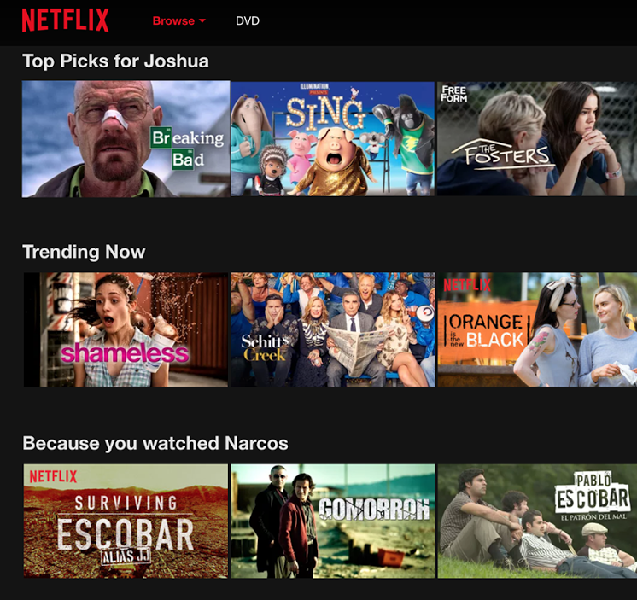
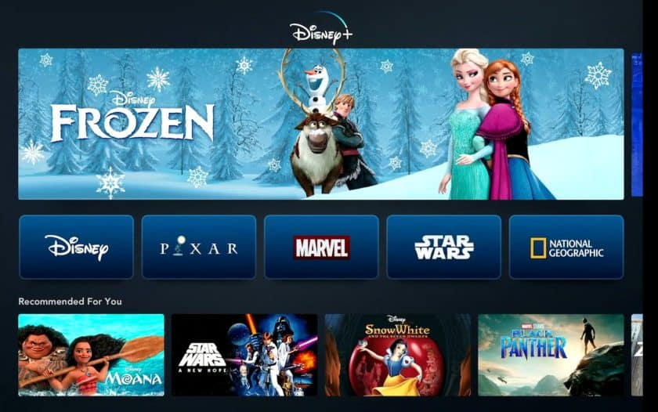
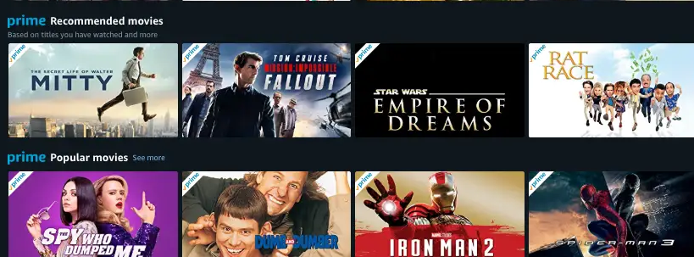
Some famous over-the-top content platforms with movie recommender systems
www.netflix.com; www.primevideo.com; https://www.hotstar.com/in

Slide 4
Our objective
Our objective was to implement a personalized Movie Recommender system.
We have implemented multiple (9) models to perform a “Recommended for You” functionality for a user.
We have implemented 1 model for “Because you watched [Movie X recently, you may also like]” option based on the last watched movie by a user (inspired by the similar option provided by Netflix).
We have implemented 3 models for a new user (cold start case), whose previous data is not available to us:
Recommending the most recent top-rated movies
Recommending movies similar to their favourite movie
Recommending top-rated movies of a genre of their choice

Slide 5
Dataset Used
We have used the MovieLens 1M data set, which contains 1,000,000 ratings on 4,000 movies from 6,000 users, for our recommendation system. The ratings section of the 1M dataset contains the following features:
movieId
userId
rating (5-star scale)
title
Timestamp
genres
In order to make our dataset more comprehensive, we have performed web scraping from IMDb over all the movies of the MovieLens 1M dataset, and augmented the MovieLens dataset with the movie descriptions obtained from there.
We have extracted the movie description from the first result displayed in IMDb search for each movie in the MovieLens dataset. We have not used additional search results since IMDb only contains one unique correct result corresponding to a movie title, and using lower ranked search results had a higher chance of appending incorrect movie descriptions to our dataset. We’ve then concatenated movie title and genre(s) to the same.

Slide 6
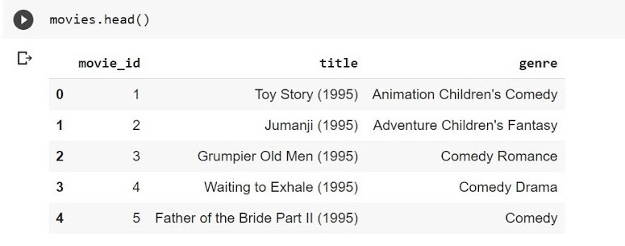
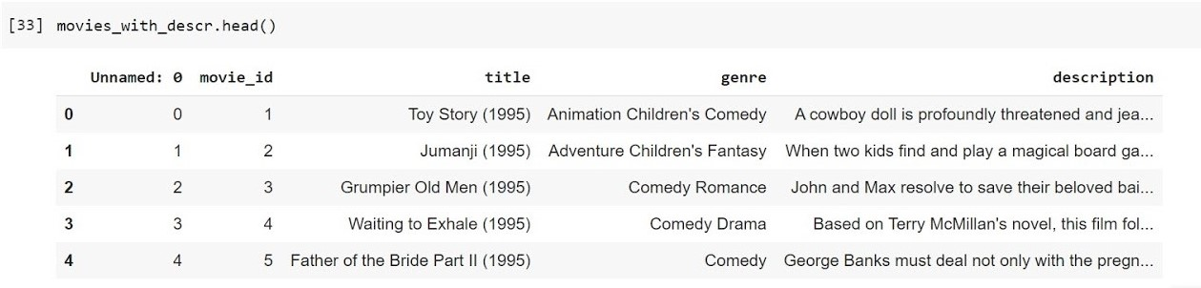
Dataset Used - Images
The movies in the original MovieLens dataset
The dataset after web scraping
Link to our final dataset after augmenting the movies after web scraping and appending movie descriptions:
https://drive.google.com/file/d/1QYCZIvQU7j7BkyvlSIQ27FdG_lPY5V5y/view?usp=sharing

Slide 7
Libraries Used
1)NLTK (stopwords) - https://www.nltk.org/
2)spaCy (Word Embeddings) - https://spacy.io/
3)NumPy - https://numpy.org/
4)Pandas - https://pandas.pydata.org/
5)sentence-transformers - https://pypi.org/project/sentence-transformers/
6)Keras - https://keras.io/
7)Keras Self Attention - https://pypi.org/project/keras-self-attention/
8)TensorFlow - https://www.tensorflow.org/
9)scikit-learn - https://scikit-learn.org/stable/
10)pickle - https://docs.python.org/3.8/library/pickle.html

Slide 8
Our Models for the “Recommended for You” Functionality
We have implemented the following methods of recommending specific movies to a user based on their past preferences and other historic data from the database:
Item - Item Collaborative Filtering
User - User Collaborative Filtering
Neural Collaborative Filtering (7 separate models)
In the following slides, we will explain our model and show screenshots of the outputs obtained for each of these.

Slide 9
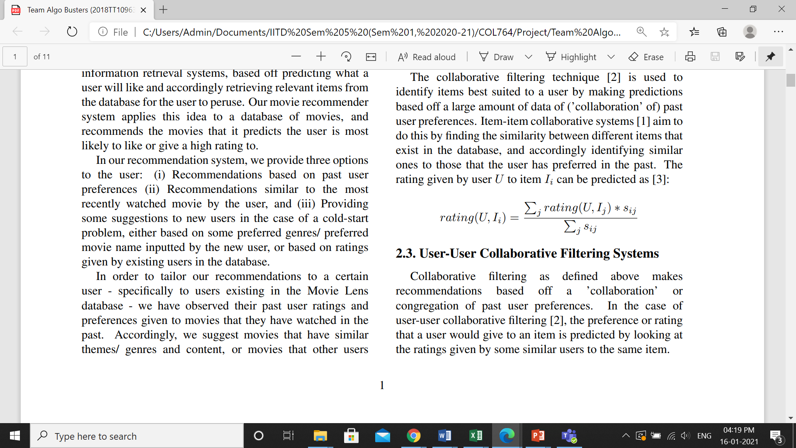
Model 1: Item-Item Collaborative Filtering
The collaborative filtering technique is used to identify items best suited to a user by making predictions based off a large amount of data of (’collaboration’ of) past user preferences.
Item-item collaborative systems aim to do this by finding the similarity between different items that exist in the database, and accordingly identifying similar ones to those that the user has preferred in the past. The rating given by user U to an item i can be predicted by:
Here, s_ij is the similarity between items ‘i’ and ‘j’, and can be computed by finding the Pearson correlation coefficient between the two items.
Sarwar, Badrul & Badrul, & Karypis, George & Cybenko, George & Konstan, & Joseph, & Reidl, & Tsibouklis, John. (2001). Item-based collaborative filtering recommendation algorithmus.
Pearson, K. (1895) Notes on Regression and Inheritance in the Case of Two Parents Proceedings of the Royal Society of London, 58, 240-242.

Slide 10
Model 1: Item-Item Collaborative Filtering
In our model, we concatenate the web scraped description, movie title and genre to create the document embedding using the pretrained RoBERTa model. We’ve utilised the SentenceTransformer library for the same. These models are quite suitable for tasks since they’ve been trained on the Siamese neural network for predicting semantic textual similarity between two sentences.
We hence define our function to calculate similarity between the user's preferred movies and other unwatched movies in the dataset in order to estimate ratings and recommend movies to the user.
Liu, Yinhan & Ott, Myle & Goyal, Naman & Du, Jingfei & Joshi, Mandar & Chen, Danqi & Levy, Omer & Lewis, Mike & Zettlemoyer, Luke & Stoyanov, Veselin. (2019). RoBERTa: A Robustly Optimized BERT Pretraining Approach.
Gregory Koch, Richard Zemel and Ruslan Salakhutdinov. Siamese neural networks for one-shot image recognition. ICML deep learning workshop, vol. 2. 2015.
Reimers, N. and Gurevych, I., 2019. Sentence-bert: Sentence embeddings using siamese bert-networks. arXiv preprint arXiv:1908.10084.

Slide 11
Our Approach and Time Complexity of Functions
We have used cosine similarity to find the similarity between two movie embeddings. Thus we have utilised the ratings of watched movies and their similarity with the movie we desire to rate.
While estimating the rating we only use top ‘k’ most similar movies, where ‘k’ is an optimizable hyperparameter. (We have chosen ‘k’ = 10 in our model). We then sort the newly rated movies in decreasing order to recommend the top movies.
For a given user, in order to recommend movies, we iterate over all movies in our dataset to predict the ratings of unwatched movies. We also create a dictionary for structure with key as user id and values as the list of movies and ratings given by them. This decreases the computational cost.
For every movie, we use the previous ratings of the user to predict the new rating . So the big O is O(len(ratings)+len(movies)*Umax), where len(movies)=total number of movies, len(ratings)=total number of ratings in the dataset, Umax= average number of movies rated by each user.

Slide 12
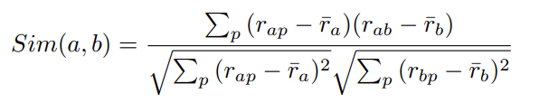

Model 2: User-User Collaborative Filtering
Collaborative filtering as defined previously makes recommendations based off a 'collaboration' or congregation of past user preferences. In the case of user-user collaborative filtering, the preference or rating that a user would give to an item is predicted by looking at the ratings given by some similar users to the same item.
Here, 'similarity' between two users ‘a’ and ‘b’ can be calculated by using the Pearson correlation coefficient using all movies ‘p’ commonly watched by both of them, as :
The rating given by user ‘u’ to any movie ‘p’ can then be estimated by this formula, where ‘users’ is a subset of the complete user database representing the top-k users similar to ‘u’. (We have chosen k=100 in our model).
Xiaoyuan Su, Taghi M. Khoshgoftaar, "A Survey of Collaborative Filtering Techniques", Advances in Artificial Intelligence, vol. 2009, Article ID 421425, 19 pages, 2009.
Pearson, K. (1895) Notes on Regression and Inheritance in the Case of Two Parents Proceedings of the Royal Society of London, 58, 240-242.

Slide 13
Our Approach and Time Complexity of Functions
We have calculated the similarity between two users using the Pearson correlation coefficient - i.e. what may be considered cosine similarity for centered vectors. For a movie the user hasn’t watched, a weighted average of the ratings given by top-k most similar other users to that movie is taken, where ‘k’ is an optimizable hyperparameter (we have chosen k=100 in our model).
We have then recommended top num-movies movies to user ‘u’ present in the MovieLens database, by sorting the predicted ratings for unwatched movies in descending order, as our recommendations to the user based on this model.
Calculating the similarity between 2 users takes O(len(movies)) time, where len(rating) is the number of ratings available in the dataset, and len(movies) is the number of movies in the MovieLens 1M dataset. Predicting user ratings for a single movie after that takes O(len(movies))*O(len(ratings)) + O(k) time. The overall recommender system hence takes O(len(movies)) time to find the unwatched movies by user u, and [O(len(movies))*O(len(ratings)) + O(k)] * O(unwatchedMovies) time overall for recommending new movies to the user.
Due to the higher time complexity of this recommendation function with very large number of movies, we have only used a small test set of 100k ratings instead of the 1M ratings set used for other model evaluations. We have thought of ways to optimize it now.

Slide 14
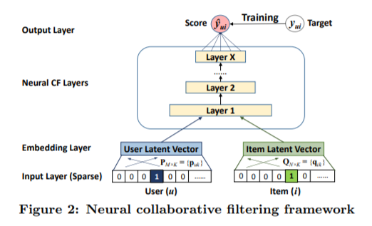
Models 3-9: Neural Collaborative Filtering
Taking inspiration from the Neural Collaborative Filtering model proposed by Xiangnan He et al., we’ve evaluated several self implemented neural architectures. This is the basic architecture architecture used by them:
Xiangnan He, Lizi Liao, Hanwang Zhang, Liqiang Nie, Xia Hu, and Tat-Seng Chua. 2017. Neural Collaborative Filtering. In Proceedings of the 26th International Conference on World Wide Web (WWW '17).
https://docs.google.com/document/d/1rtsJOChtFL7xlAEdbA8G4frhINIfrzROGPjzj75BvTM/edit?usp=sharing

Slide 15
Our Model for “Because you watched [Movie X recently, you may also like]”
We have utilized the timestamps available in the MovieLens data to recommend the most similar num_movies movies to the latest movie watched by the user.
We have done this as an extended application of our item-item collaborative filtering function.
This is inspired from Netflix’s idea of doing the same with respect some movie that a user has recently completed watching.

Slide 16
Our Models for a New User (in the Cold Start case)
In the case where we need to provide movie recommendations to a new user whose previous data is not available to us, we have come up with three models:
Returning the top-rated, most-recently-watched movies of the database (using average rating and average timestamp from our dataset for the movies).
Taking the user’s favourite movie as input, and recommending most-similar movies (using our item-item collaborative function).
Taking the user’s favourite genre as input, and recommending top-rated, most-recently-watched movies from the dataset (using the requisite available data for each movie of the dataset).

Slide 17
Runtimes
Model | Runtime (10 folds)
Item-Item | 61 hrs
NCF1 | 1 hr
NCF2 | 6 hrs
NCF3 | 10 hrs
NCF4 | 45 hrs*
NCF5 | 53 hrs*
NCF6 | 19 hrs
NCF7 | 25hrs
All the models except NCF4 and NCF5 were run on HPC with 8 cpu cores. NCF4 and NCF5 had to be run on google colab as they’d have taken approximately 13 and 15 days respectively had they been run on HPC cpus.

Slide 18
Metrics Used for Evaluation
We have primarily used the following metrics in our evaluation:
1) RMSE (Root Mean Squared Error)
2) NDCG, NDCG@10
3) Recall@10, Recall@100
4) Precision@10, Precision@100
5) MRR (Mean Reciprocal Rank)
6) MAP (Mean Average Precision)
7) Statistical Significance Tests: Paired Student’s t-test and Wilcoxon Signed Rank Test

Slide 19
Our Method of Calculating Results and Evaluation Metrics
We have run 10-fold cross validation on each of our models, wherein we evaluated the models 10 times by dividing the dataset into train and test sets in a 90:10 ratio each time.
For item-item collaborative filtering and our models for neural collaborative filtering, we have used the entire 1M dataset for our 10-fold cross-validation. For user-user collaborative filtering, due to the higher time complexity with respect to unwatched movies, we have run the cross-validation on a test set of 1/10th size.
Our method of creating qrels files to use in trec_eval:
From the available ground truth ratings of the dataset, we have considered a movie to be “relevant” to a user when its user-rating is above a certain threshold.
We have considered 3 cases for each model: when this threshold is >=3, >=4 and >=5, separately.
Hence, for each fold of cross-validation, we have generated 3 corresponding qrels files as well as 3 possible results files in order to run these files on trec_eval and calculate the relevant metrics.
Voorhees, Ellen & Harman, Donna. (2005). TREC: Experiment and Evaluation in Information Retrieval.

Slide 20
Final Results
We find that on almost all metrics, our best results are obtained on our 6th and 7th Neural Collaborative Filtering architectures. We have not included user-user collaborative filtering results in our comparison since that was performed on a smaller dataset.
Our results across the various models are available on this link:
https://docs.google.com/spreadsheets/d/1KVXD6MGQhXYBByOostWGwVohUvSFoYZ9a-9GHZVUo3o/edit#gid=0

Slide 21
Comparison with State-Of-The-Art
In terms of RMSE, current state-of-the-art model for this dataset is the Bayesian Time Flipped SVD++ [1] with rmse score of 0.818. They improved the time SVD++[2], an extension of singular value decomposition, by proper hyperparameter selection and adding a time and bag of word predictor variable. In terms of NDCG, current sota model is KTUP model[3] with a NDCG score of 0.699. They use knowledge graphs to model user-item interaction and create the recommendation model
So on comparing, our rmse results for several neural architecture are very close to the latest sota results, For NDCG, although they haven't specified the relevance threshold used for NDCG calculation, our neural collaborative filtering models are in line with the current sota results.
[1]https://arxiv.org/pdf/1905.01395v1.pdf
[2]Koren, Y. Collaborative filtering with temporal dynamics. In Proceedings of the 15th ACM SIGKDD International Conference on Knowledge Discovery and Data Mining (New York, NY, USA, 2009), KDD ’09, ACM, pp. 447–456.
[3]https://arxiv.org/pdf/1902.06236v1.pdf
https://paperswithcode.com/sota/collaborative-filtering-on-movielens-1m

Slide 22
Other Benchmarks
Model | RMSE
NCF7 | 0.866
SVD | 0.873
SVD++ | 0.862
NMF | 0.916
Slope One | 0.907
k-NN | 0.923
Centered k-NN | 0.929
k-NN Baseline | 0.895
Co-Clustering | 0.915
Baseline | 0.909
Random | 1.504
Scikit-surprise library has inbuilt optimized implementations of some of the benchmark models. The results on 1M dataset are mentioned in the following table.
https://test.pypi.org/project/scikit-surprise/

Slide 23
Result Analysis
On comparings results with other models, we realize that our neural models, especially NCF6 and NCF7 are giving sota results in all the metrics - rmse, ndcg, etc. The success of NCF6 and NCF7 over other neural models can be attributed to combining LSTM encoder (+Attention) with transformer based sentence embeddings. While our item-item and user-user based collaborative filtering lag behind in rmse scoring but their ndcg scores are close to the sota results. So while these models may not be excellent in predicting the exact rating for a new movie, but they can definitely recommend movies to the user, thereby accomplishing the objective.

Slide 24
Analysis of Statistical Significance Tests
We’ve compared our models by running Paired Student’s t-test and Wilcoxon Signed Rank Test. We’ve used 0.01 as the significance level. We’ve run these tests on every possible combination of our models . Most of our models our statistically different from each other thus justifying the results of better models. In some models such as NCF1 and NCF2, they’re coming out to be statistically similar based on paired student’s t test. NCF1 is also coming out to be similar to NCF4 based on the same test. However NCF2 and NCF4 are statistically different thereby implying that that similarity between NCF1 and NCF2 is probably anomaly. There were 2 more cases of statistical significance but they can also be rejected by similar arguments. Therefore statistical significance tests further validates the better results of neural models especially NCF6 and NCF7.

Slide 25
Scope for additional work
Recommendations determined from the bulk (quantity) of users viewing a movie combined with timestamp could be used to recommend ‘popular’/ ‘trending’ movies.
We can improve the performance of neural architectures through pre-training on other datasets.
We can also deploy a complete transformer based encoder network instead of the LSTM one.
To better address the cold start problem, we can scrape data from their twitter/other social media handle and use that for initial recommendation.

